Slide 1
Meeting Organization Objectives through Quality
Umesh H V

Slide 2
Content
Definition of Objective
Sources of Organization Objectives
Aligning Objectives and Quality
Building Metrics Environment
Capability Analysis
Improvements
Performance matters

Slide 3
Definition of Objective
The word “Objective” is derived from Goals & Mission of the organization
Definition
A specific result that a person or system aims to achieve within a time frame and with available resources
Management technique where managers and employees work together to set, record and monitor goals for a specific period of time

Slide 4
Sources of Objectives
VoC- Voice of Customer
Contract, Legal, Statutory and country / region specific
VoB – Voice of Business
Revenue Target, Growth, Profits, EPS & RoI
VoP- Voice of Process
Compliance to Organization, Statutory, Land of native laws, National, International standards & Legal
Time
Quality
Cost
Scope

Slide 5
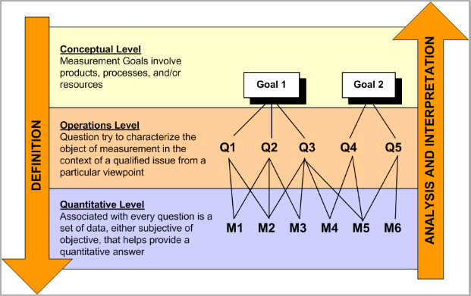
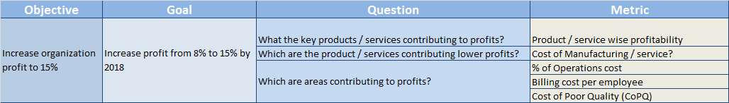
Aligning Objectives and Quality
Goals-Question-Metric (GQM) is the popular technique used to align Organization objectives and Quality
GQM Example:

Slide 6
Aligning Objectives and Metrics
VoC
VoC | Schedule Variance Revenue Variance Profit Variance Cost of Quality External Defects Density
VoB
VoP | Customer Satisfaction Internal Defects Density Defect Removal Efficiency
Schedule Variance
Revenue Variance
Profit Variance
Cost of Quality
Customer Satisfaction
Internal Defects Density
External Defects Density
Defect Removal Efficiency
VoB
VoP

Slide 7
Building Metrics Environment
Identify source of data
Improve
Define data collection methods
Analyze
Collate Data

Slide 8
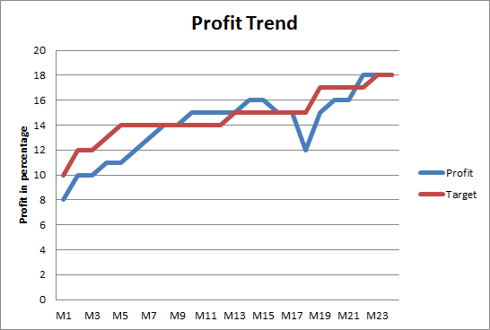
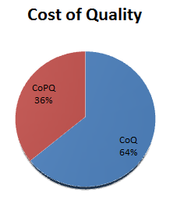
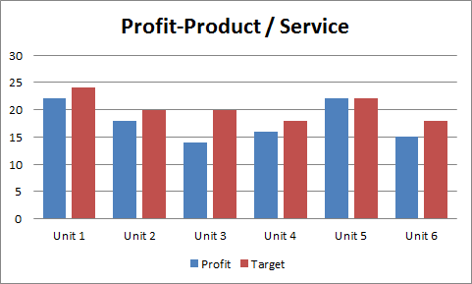
Capability Analysis
Collate data as per predefined frequency
Identify outliers
Analyze data against defined goals
Conduct Causal Analysis (if necessary)

Slide 9
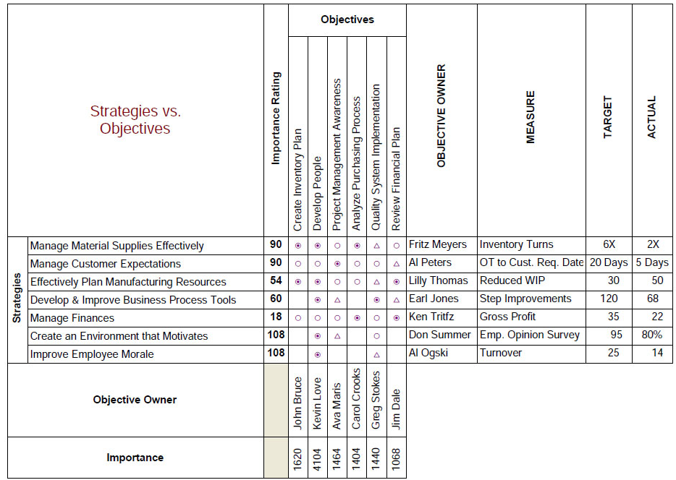
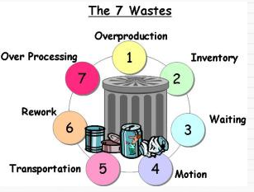
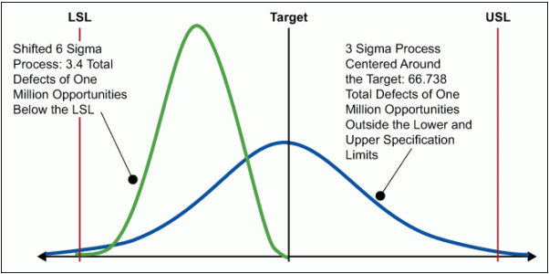
Quality levers for Improvements
TQM
Hoshin kanri
Lean
Six Sigma

Slide 10
Improvements through Q-Levers
Improvements
Impact
What Changed?
Revenue increased to INR 120K from 18K
Increased Revenue by 5 times
Portfolio & Processes
VoC
Added 1.2 Million new customers without additional IT infrastructure
Technology
Saved 7 Million USD for 3 years
VoB
Consistent 10 /10 Customer Satisfaction rating for last 4 years
Satisfied customer – Repeat orders & Additional business
Process & Technology
VoP
Reduced Turn Around Time to 3 days from 16 days
Increased capacity around 50% with out additional resource
Process
Reuse of assets reduced 12% of effort
1.8 Million USD savings by reduced cycle
Improved Time to Market
Process & Technology

Slide 11


Performance matters
Market Leadership
Revenue Growth
Consistent Profits
Product / Service Portfolio
Time to Market
Customer Satisfaction
Impact on Topline (Revenue)
Impact on Bottom-line (Profit)
Employer-Employee relationship
Vendor-Vendee relationship

Slide 12

Q&A

Slide 13


